Slide 1

NUECES RIVER AUTHORITY
Harbor Island Desalination Project
Industry Event Briefing
July 10, 2025
John Byrum III, NRA - Executive Director
Lauren Gonzalez, BV - Planning & Regulatory Permitting Lead, Water
Sarah Garza, Port of Corpus Christi - Director of Environmental Planning and Compliance
July 10, 2025

Slide 2
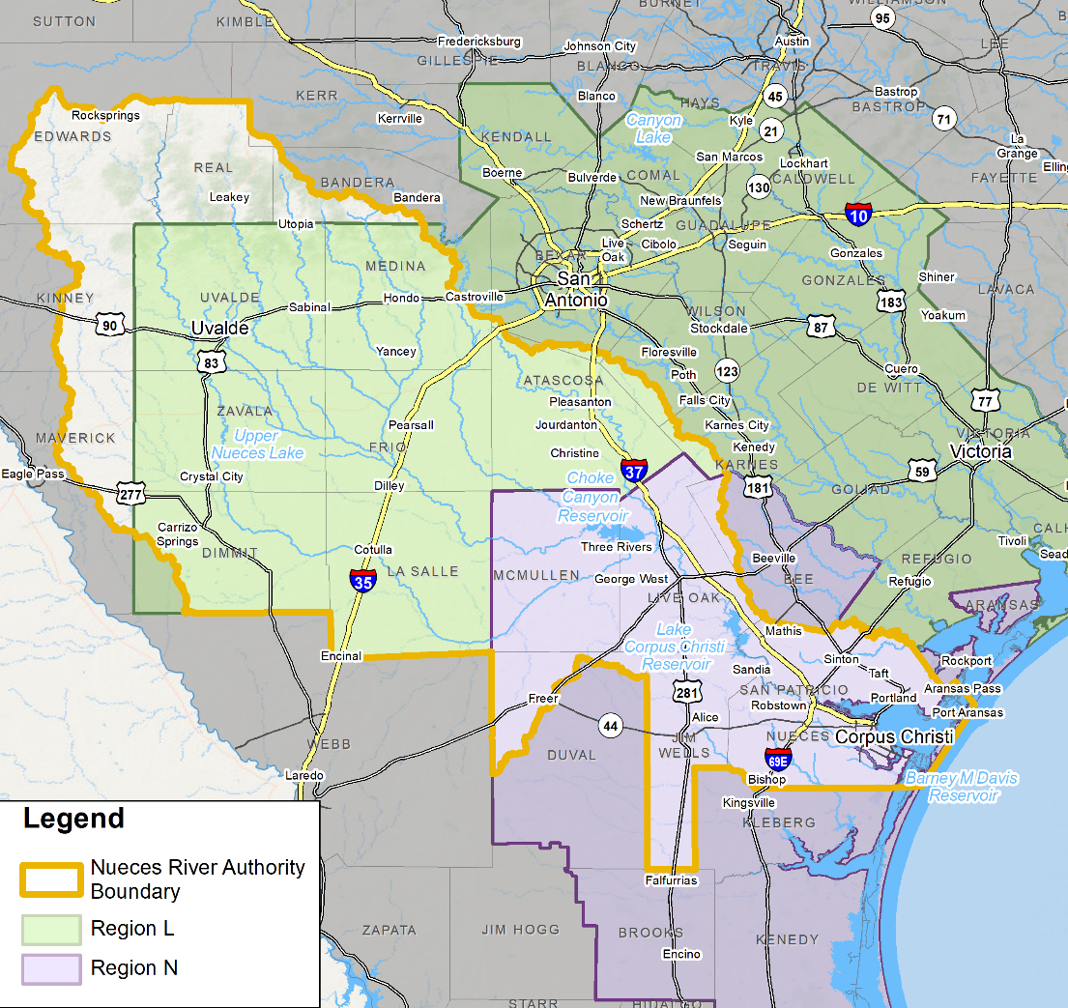
Nueces River Authority | Agency Overview
Nueces River Authority (NRA) was created by special act of the 44th Texas Legislature in 1935, functions primarily as a regional water resource planning agency:
Jurisdiction includes all or part of 22 counties in South Texas covering 17,000 square miles
Governed by a governor-appointed Board of 21 directors
Broad authority to preserve, protect, and develop surface water resources including flood control, irrigation, navigation, water supply, wastewater treatment, and water quality control
Political sponsor and voting member of the Coastal Bend (Region N) Regional Water Planning Group (RWPG) and voting member of the South Central Texas (Region L) RWPG

Slide 3
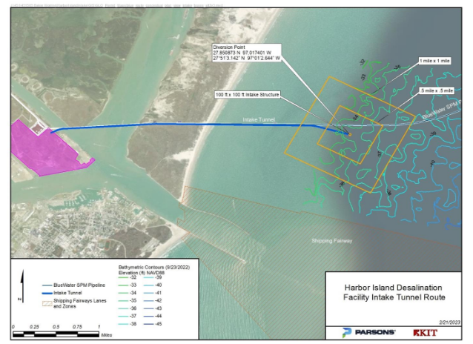
Harbor Island | Project Overview - Private Partner
Plant
Phase 1: 100 MGD reverse osmosis seawater desalination treatment plant located on Harbor Island, to include:
Offshore marine works (seawater intake and brine discharge facilities)
Electrical distribution to Harbor Island and onsite power facilities

Slide 4
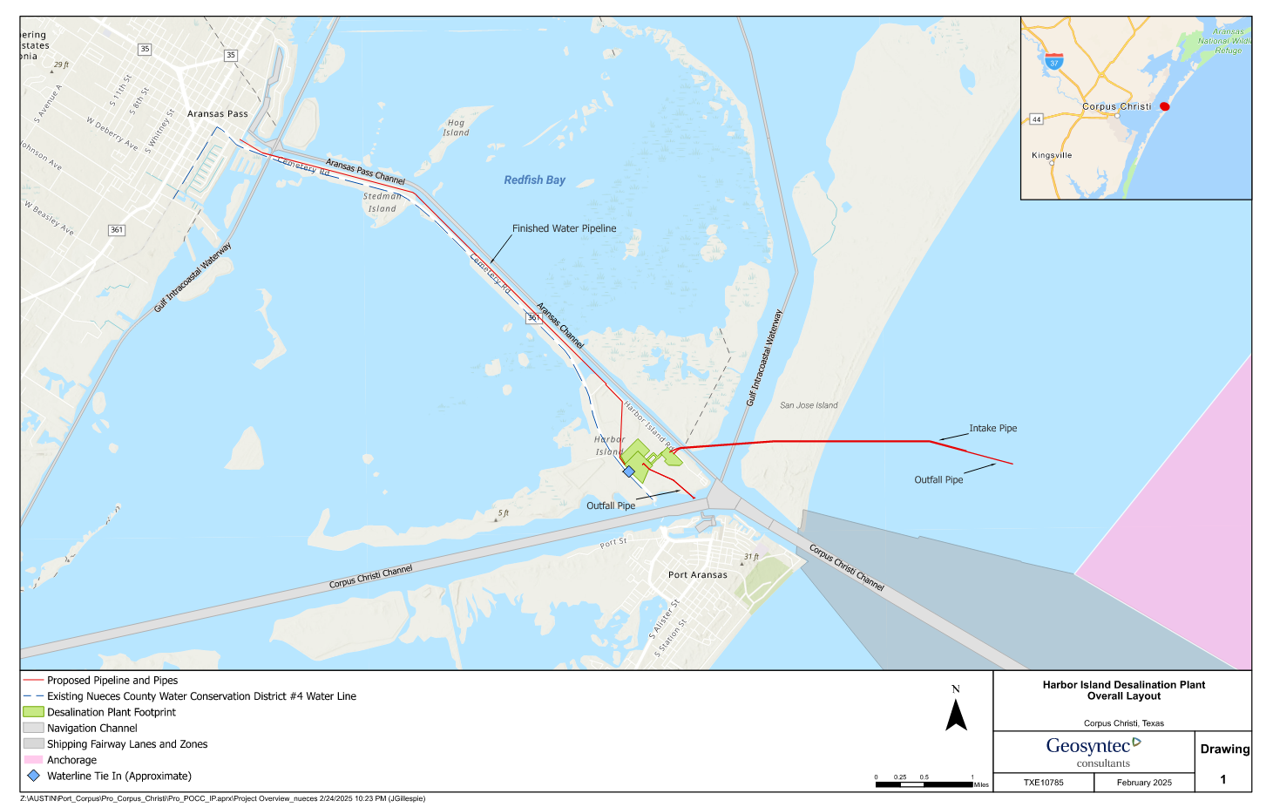
Harbor Island | Project Overview - Private Partner
Product Water Pipeline
Approximately 6 miles of product water pipeline to a delivery point* in Aransas Pass, as described in the Port of Corpus Christi’s TCEQ and USACE and GLO permits and approvals
* Product water will connect to a regional distribution system separately financed, designed, built, owned and operated by NRA

Slide 5
Harbor Island | Project Overview - Public Agency
Water Distribution Pipeline
Regional distribution pipeline system to be separately financed, designed, built, owned and operated by NRA
The final pipeline size and route will be dependent on the location and demands of the end users in Regions L & N, and potential oversizing to allow for future expansion
Sizing will be up to 84" in diameter
A pump station located at the Treatment Facility, with additional booster pump stations as required
Preliminary Alignment / Design - Fall 2025
Detailed Design - 2026

Slide 6
Regional Water Planning Overview

Slide 7
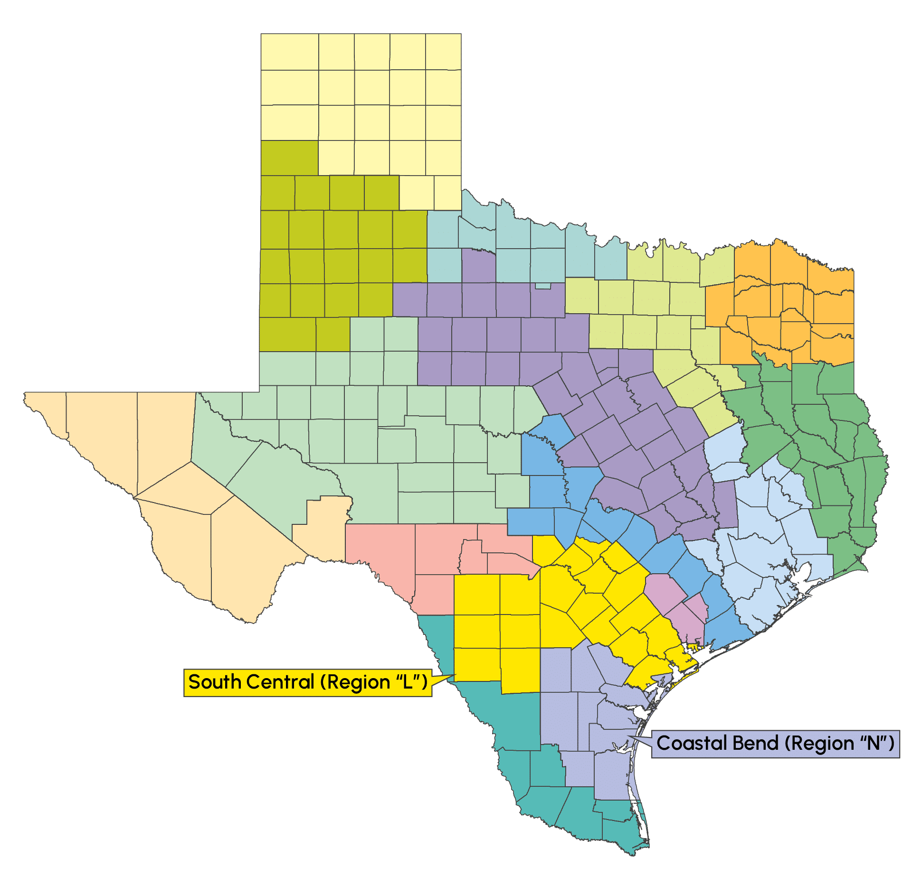
Regional Water Planning in Texas | Overview
Administered by the Texas Water Development Board (TWDB) and a political subdivision
Each RWPG creates its own regional water plan
Plans are updated every 5 years with a 50-year planning horizon
Plans study and consider:
  Population and water demand projections;
  Water supply and availability projections;
  Water needs; and
  Water management strategies (WMSs) and their impacts
NRA’s jurisdiction is primarily within Region L and Region N
Notes:
Regional water planning in Texas began in 1997. The process is administered by the Texas Water Development Board, or TWDB also known as the board, and consists of the development of a 50-year water supply plan for each of 16 regions in the state. These regions are designated as letters A through P.
Each of the 16 regions develops its own regional water plan.
The state’s regional water planning process begins by studying and considering population and water demands. These are estimated now and projected forward over the next 50 years;
We then use models to determine water supply availability during drought of record conditions.
Existing water supplies are then compared to the water demand projections to identify shortages (also referred to as water needs).
Then, we develop water management strategies to meet these needs and evaluate the impacts of these strategies on the region and natural resources.
From TM Basis of Design Report - Intake Permit Feb 2023 notes:
If projected future water needs are not met, the TWDB has forecast that Region N will suffer combined lost income of $1.9 Billion by 2030 and $6.9 Billion by 2070
A loss of 13,000 jobs by 2030 and loss of 48,000 jobs by 2070
And consumer surplus losses of $163 million by 2030 and $172 million by 2070

Slide 8

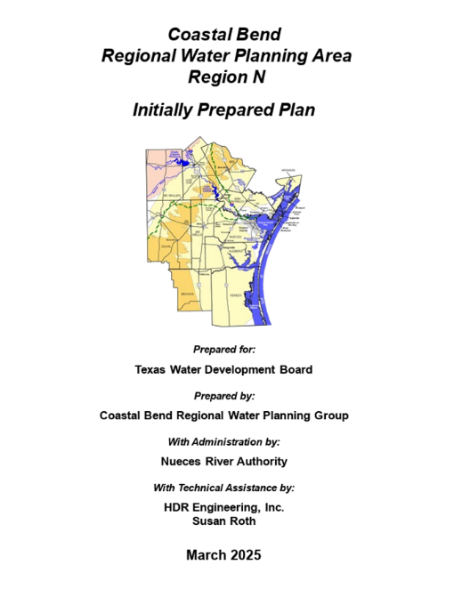


Regional Water Planning in Texas | Overview
Draft regional water plans or Initially Prepared Plans (IPPs) were published in March 2025
Final regional water plans will be adopted by RWPGs and submitted to the TWDB by October 2025
South Central Texas
(Region L) IPP found at www.RegionLTexas.org
Coastal Bend
(Region N) IPP found at
www.CoastalBend-RWPG.org

Slide 9
Rising Demand: Impacts of Rapid Population Growth
Demands in Regions L and N are projected to increase by 30% over the planning horizon
Source: Regions L and N IPPs
Notes:
The IPPs for Regions L and N show that the demands in Regions L and N are projected to increase by 30% over the planning horizon. The majority of the demands in both regions are for municipal (turquoise), manufacturing (light orange), and irrigation (dark blue) uses. The growth in municipal demand is driven by unprecedented population growth. It’s projected to increase by nearly 20% in the next decade and by 81% over the next 50 years.
Another thing to note about this figure is the existing supplies shown in orange. Even though the demands are increasing, existing supplies are projected to remain relatively constant, underscoring the need to develop new sources of water supply in both regions to meet these growing demands.
The delta between supplies and demands indicates that we’ll have a water need or shortage.

Slide 10
Facing the Gap: Projected Shortages Without New Supply
Projected Needs in Regions L and N are greater than 500 MGD in 2080
Source: Regions L and N IPPs
Notes:
Those shortages are shown here on this figure. We take supplies and subtract the demands. If the result is a positive number, then there’s a surplus of water available during a repeat of the drought of record. If it’s negative, then that indicates there are needs or shortages.

Slide 11
Meeting the Challenge: Strategies to Develop New Water Supplies
 | Recommended WMS Type | 2080 Approx Yield (acft/yr)
 | New Reservoir | 30,000
 | Surface Water | 130,000
 | Seawater Desalination | 258,000
 | ASR | 35,000
 | Brackish Groundwater | 138,000
 | Fresh Groundwater | 76,000
 | Reuse | 120,000
 | Other* | 371,000
Total WMS Yield (acft/yr) |  | 1,158,000
* Includes conservation, drought management, reallocation of other sources, weather modification, rainwater harvesting, and others
1.16M
acft/yr

Slide 12
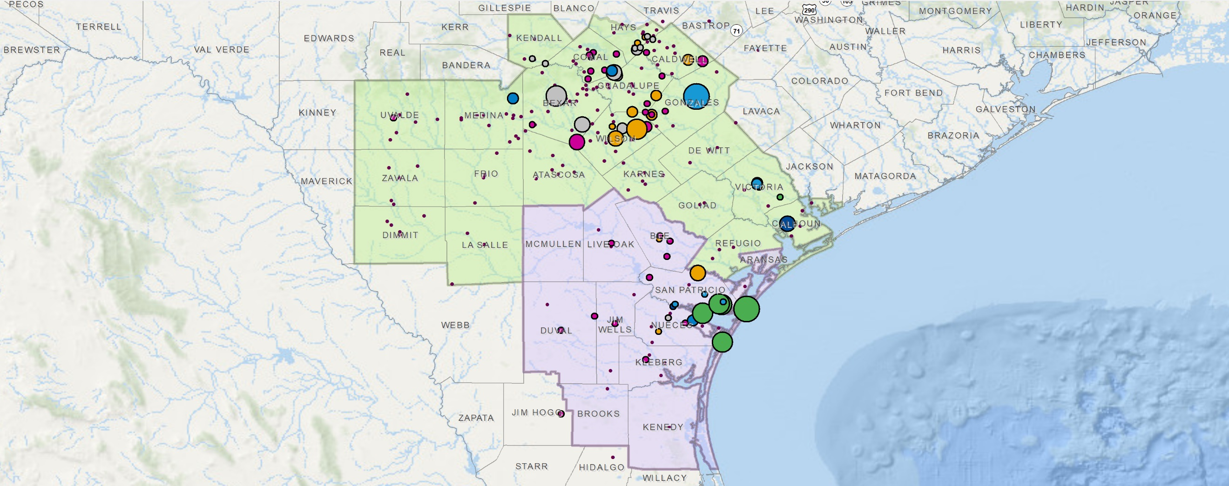
Meeting the Challenge: Strategies to Develop New Water Supplies
WMS Type
 | New Reservoir
 | Surface Water
 | Seawater Desalination
 | Aquifer Sto. & Recov (ASR)
 | Brackish Groundwater
 | Fresh Groundwater
 | Reuse
 | Other*
* Includes conservation, drought management, reallocation of other sources, weather modification, rainwater harvesting, and others
Aquifer Storage and Recovery
Brackish Groundwater
Fresh Groundwater
Seawater Desalination
  Harbor Island Desalination Project (100 MGD) is listed as a Recommended Strategy in the
  Region N IPP
Both Regions Recommend a Diverse Portfolio of Water Management Strategies (WMSs)
Notes:
Harbor Island Desalination Project
Desalination Accounts for largest volume of recommended WMSs out of all of the other WMS types.

Slide 13
Permitting Updates

Slide 14

Port of Corpus Christi
Harbor Island Desal Update
NRA Industry Meeting
July 15, 2025

Slide 15


Permit Process Overview + Status
Permit Type | Agency | Description | Status
Lease & Easement (Offshore intake) | GLO | Authorizes placement of structures on state-owned submerged lands | Received.
Offshore Water Rights (100MGD net) | TCEQ | Authorizes intake in Gulf of Mexico | Application submitted and under technical review.
Section 10/Section 404 (multiple scope elements) | USACE | Addresses potential habitat impacts (temporary) from activities in Waters of the US | Submitted Feb ’25 through FAST 41; Public Notice complete; ESA Consultation complete; 408/RE review underway.
Offshore Discharge Permit (100 MGD net) | TCEQ | Discharge in Gulf of Mexico | Submitted April 1, 2025. First Public Notice complete on 7/12/2025.
Easement Amendment (Offshore discharge) | GLO | Authorizes placement of structures on state-owned submerged lands | Not yet submitted; submitting 3Q ‘25
15

Slide 16

Regulatory Strategy
Desalination at Harbor Island
Objectives:
Uphold the Port’s commitment to science-based, data-driven design/decision making
Uphold the Port’s commitment to environmental stewardship
Obtain, as expediently and cost effectively as possible, all remaining permits needed to authorize a scalable desalination facility at Harbor Island
Maximize optionality in terms of facility configuration and construction
16

Slide 17








Six Environmental Precepts
Environmental Planning and Compliance
Air Quality
Climate Action
Water Quality
Reduce emissions by 15% in PM, VOCs, NOx, SOx every 3 years
Reduce GHG emissions
per cargo ton by
7.5% annually
Reduce AL, Fe, Zn,
Pb, TSS by 10% annually
Climate
Adaptation
Habitat
Restoration
Soils &
Sediments
Implement Life Cycle Assessment tool on
Port capital projects
Create/restore 50 acres
of habitat every 3 years
Remediate spills to
residential standard
17

Slide 18
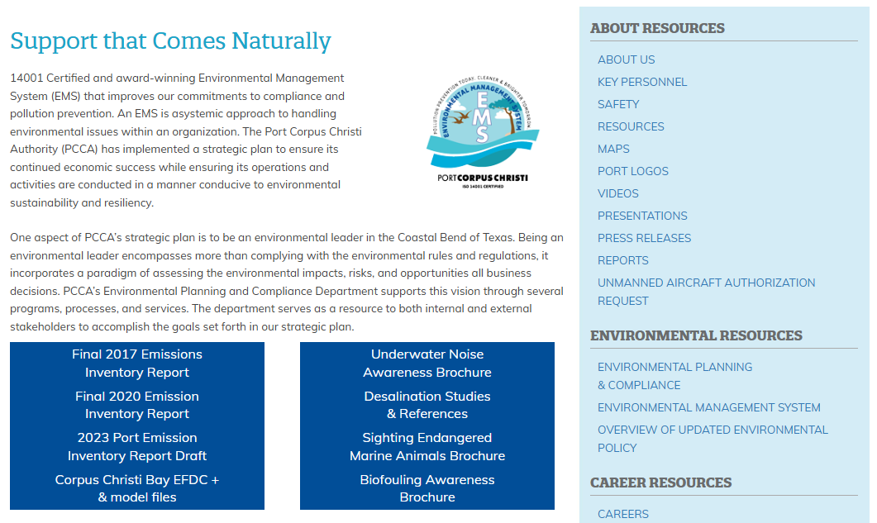




Studies + Reports + Permit Applications Completed to Date, Available at www.portofcc.com
Reports, Studies and Modeling found under:
ABOUT / Environmental Planning & Compliance
Desal permit applications found under:
COMMUNITY / Public Notifications
18

Slide 19
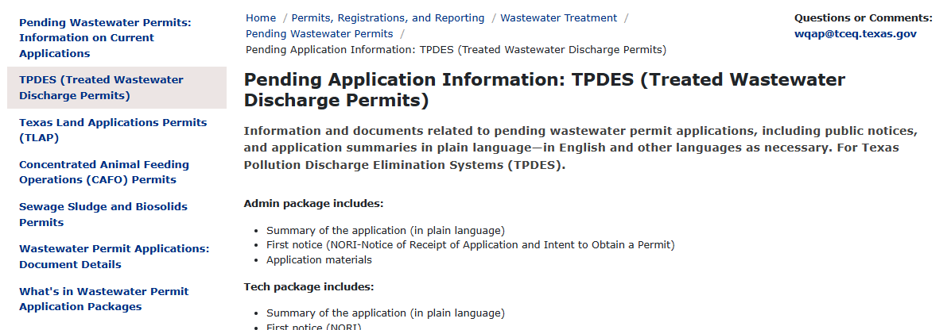
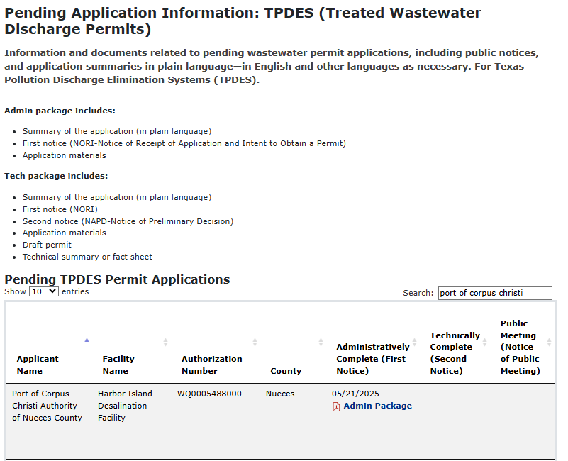




Regulatory Permit Applications for Public Notice
on Agency Websites
TPDES permit application found at https://www.tceq.texas.gov/permitting/wastewater/pending-permits/tpdes-applications
USACE permit applications found at https://www.swg.usace.army.mil/Media/Public-Notices/
19
https://www.tceq.texas.gov/downloads/permitting/wastewater/title-iv/tpdes/wq0005488000-portofcorpuschristiauthorityofnuecescounty-harborislanddesalinationfacility-nueces-tpdes-adminpackage.pdf

Slide 20
Initial Stakeholder Briefings
Note: Briefings are still ongoing…
Stakeholder | Attendees | Date | Contact Method
City of Corpus Christi | Mayor Paulette Guajardo, Peter Zanoni, & Andrew Molly | December 9, 2024 | In-Person
City of Port Aransas | Mayor Wendy Moore & David Parsons | December 3, 2024 | In-Person
Nueces County | Judge Connie Scott Commissioner Brent Chesney | December 2, 2024 | In-Person
City of Portland/San Patricio County Municipal Water District/San Patricio County | Mayor Cathy Skurow, Brian Williams, & Judge David Krebs | December 4, 2024 | In-Person
University of Texas, Marine Science Institute and Harte Research Institute | Various Staff | December 3, 2024 | In-Person
Office of Texas State Senator Morgan LaMantia | Senator LaMantia & Jose Pereida | December 4, 2024 | Virtual
Office of U.S. Senator Ted Cruz | Javier Salinas & Tim Kocher | December 5, 2024 | Virtual
Office of Congressman Michael Cloud | Mark Longoria | December 5, 2024 | Virtual
Office of U.S. Senator John Cornyn | Laura Atcheson, Andi Dooley, &Charles Brittingham | December 12, 2024 | Virtual
Port Commission Meeting | Port Commissioners, Port Staff, Public | January 21, 2025 | In-Person / Virtual
City of Corpus Christi Alternative Water Supply Workshop | City Council, City Staff, Public | March 6, 2025 | In-Person / Virtual

Slide 21
Summary of Potential Impacts (Avoided or Minimized)
Potential Impact | Avoided or Minimized | Description of Measures
Wetlands, SAV, oysters | Avoided | Situate facilities to avoid impacts Utilize HDD/micro-tunneling/tunneling
Larval Fish | Minimized | Locate intake / discharge in Gulf of Mexico in 35’+ of water Locate intake ~20’ below surface Reduce flow velocity (≤0.5 ft/s)
Marine Life / T&E Species | Avoided | Locate intake / discharge in Gulf of Mexico in 35’+ Locate intake ~20’ below surface Reduce flow velocity (≤0.5 ft/s) Intake includes bar screens
Benthic Organisms | Avoided | Locate intake and discharge at least 5’ above sea floor
Salinity | Minimized | Use of diffuser technology to mix salinity to diffuse brine to less than 2 ppt over ambient 100 meters from discharge point Discharge in Gulf of Mexico
Cultural Resources | Avoided | Designed to avoid identified cultural resources
21

Slide 22
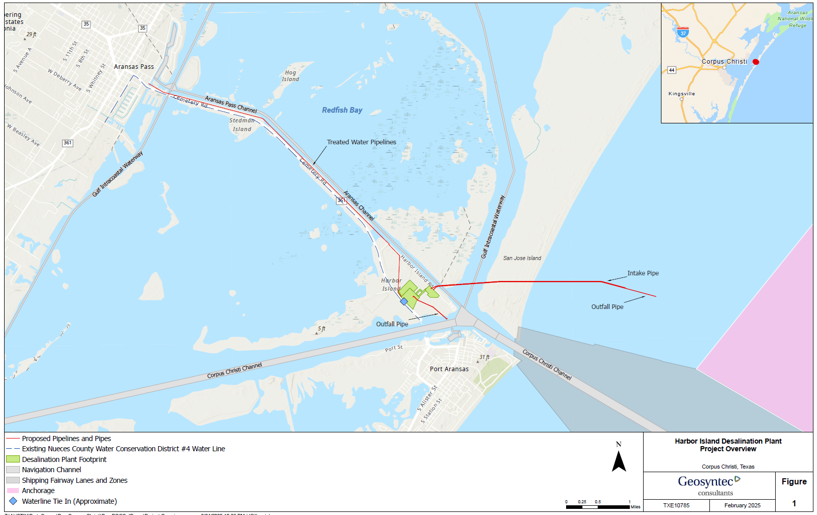
Overall Plan
22
Notes:
An offshore intake structure is planned to minimize potential environmental interaction with nearshore marine life that occur / pass through the Aransas Pass tidal inlet.
An offshore discharge is planned to address concerns of discharge in the channel and plan for larger starting facility size
Onshore Diffuser (adjacent to ship channel):
Diffuser 60 feet below surface
Maximum effluent percentages at each mixing zone
Salinity limit of 2 ppt over ambient 100 m from outfall (average ambient salinity range ~ 30 ppt – 35 ppt)
Monitoring plan to ensure compliance

Slide 23
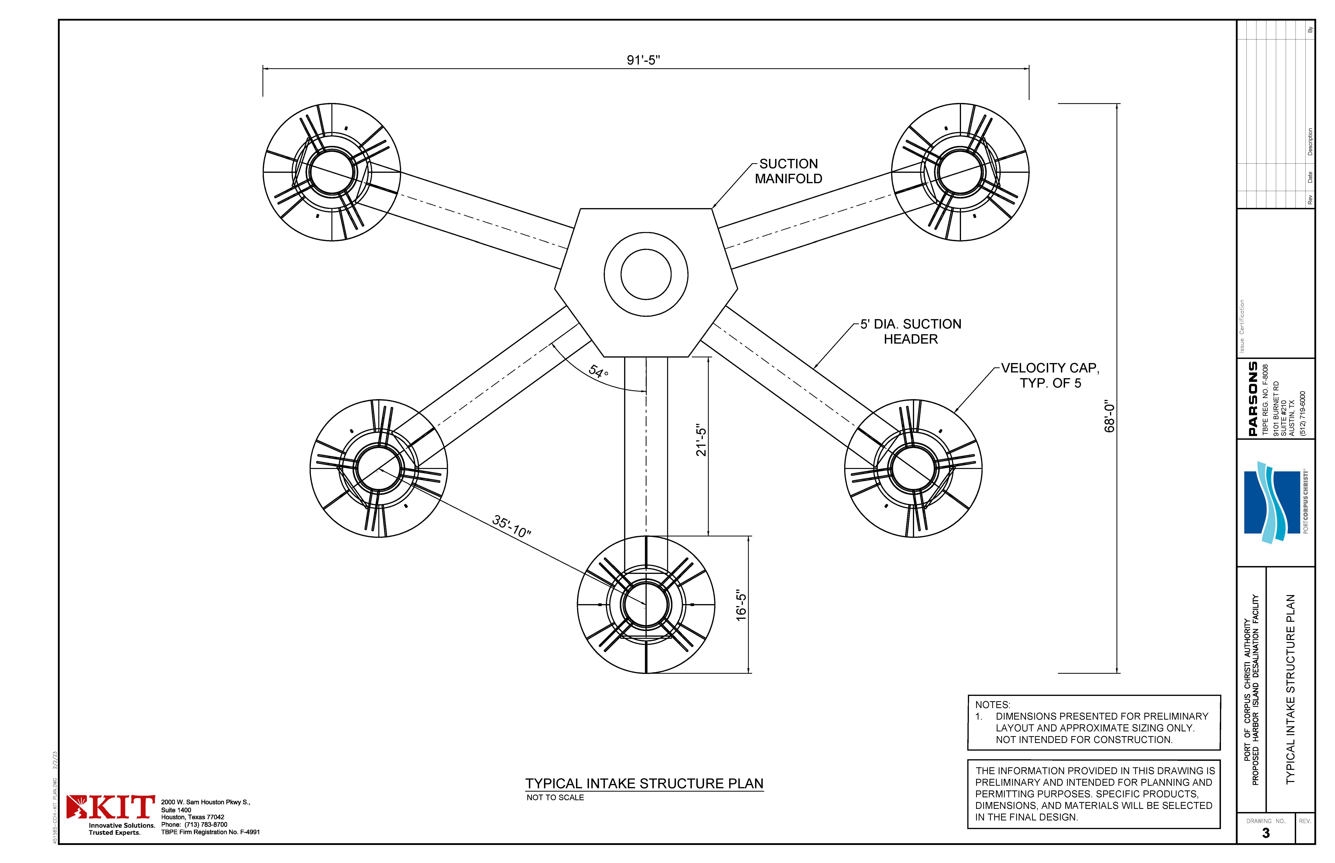
Intake Structure
Permit application and proposed conceptual design represent maximum design for facility
Detailed design will be required to comply with representations in the permit application and the final permit conditions
Notes:
For an initial production of 50 mgd, the intake structure will have a manifold arrangement with approximately four to five branches to the velocity caps.
All the branches will be evenly spread approximately 30 ft apart to obtain even flow distribution without interference from each other.
The intake opening will be approximately 5 to 10 ft above the sea bed to minimize the potential for sediments or benthic organisms to be drawn into the intake structure.
The velocity cap opening will be designed to have ≤0.5ft/sec entrance velocity to reduce the intake of fish and other marine organisms into the intake and mitigate impingement.
Initial Construction –175,000 acres-feet/year at a max diversion rate of 109,000 gpm
Potential Future Expansion – 350,000 acres-feet/year at a max diversion rate of 217,000 gpm

Slide 24
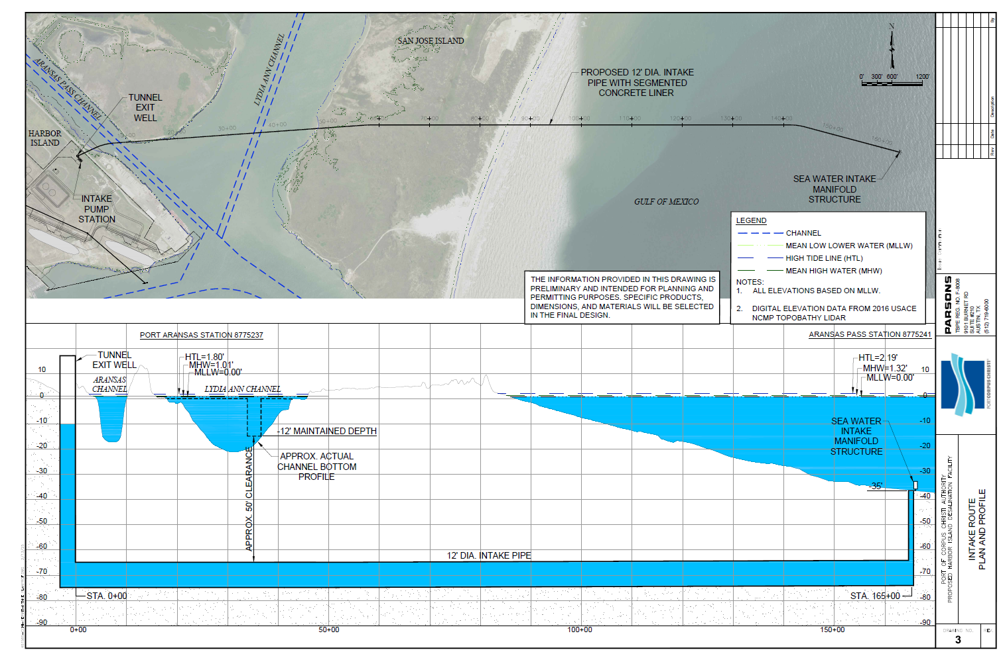
Intake Structure & Tunnel
Notes:
Intake pipe follows path of BWTT.
The Port is planning to invest in an underground pipe, which will be installed using Tunnel Boring Machine methodology to minimize impacts to special aquatic sites and waters of the US .
All pipe is below sea bed and top of pipe will be -65 feet NAVD88.
Tunnel will have a 14 ft outer diameter and 12 ft inner diameter.
Entrance for TBM will be at Harbor Island upland property.
Intake located 1.3 miles off San Jose Island following BWTT route in 35’ of water in the Gulf of Mexico with overall 3.1-mile intake pipe from Harbor Island.
100MGD requires diversion of 301.4 MGD of seawater.

Slide 25
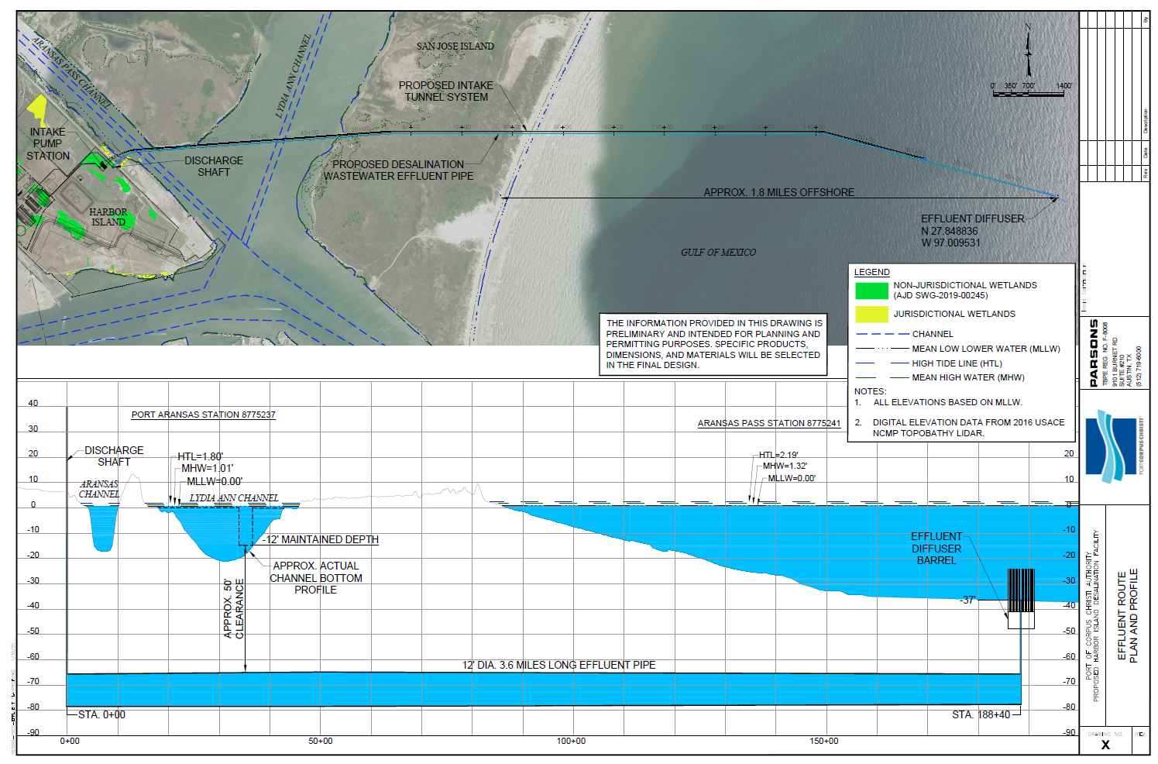
Discharge Structure & Tunnel
Notes:
Diffuser (outfall) pipe will follow intake and run adjacent to intake pipe.
Pipe will be installed using Tunnel Boring Machine methodology to minimize impacts to special aquatic sites and waters of the US.
All pipe is below sea bed and top of pipe will be -65 feet NAVD88.
Tunnel will have a 14 ft outer diameter and 12 ft inner diameter.
Entrance for TBM will be at Harbor Island upland property.
Diffuser located 1.8 miles off San Jose Island following BWTT route in 35’ of water in the Gulf of Mexico with overall 3.6-mile discharge pipe from Harbor Island.

Slide 26
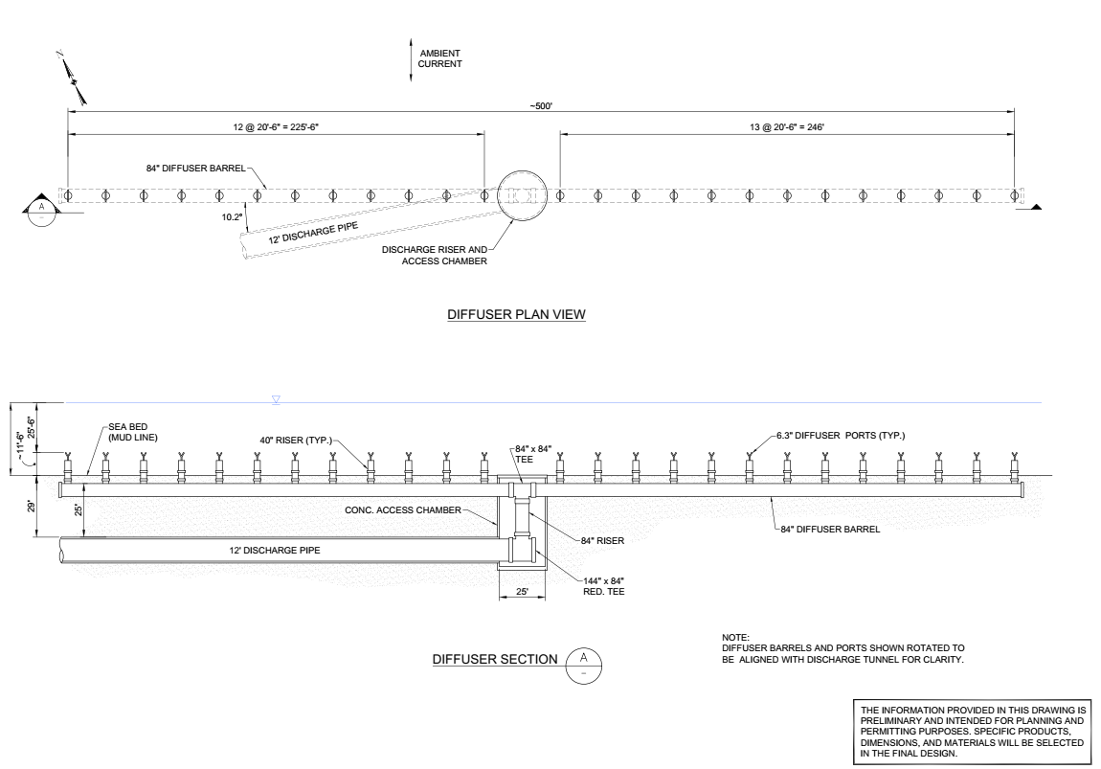
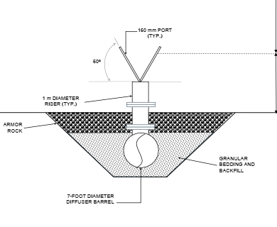
Diffuser Detail
Designed for max dispersion with effluent discharge characteristics – 191.2 mgd
500 feet long, 84” Barrel,
25 Ports with Y shaped nozzles
Approximately 11’ 6” off bottom and 25’ 6” from surface (MLLW)

Slide 27



Thank you

Slide 28
Lease Status and Delivery Approach

Slide 29
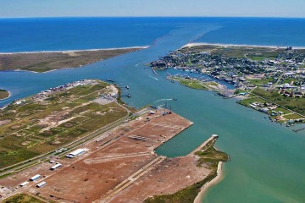
Harbor Island | Lease Agreement Port of Corpus Christi
30 acres of Port-owned land on Harbor Island
50-year agreement plus 25-year extension option
Right to build and operate seawater desalination plant and supporting infrastructure
Product water pipeline easement rights
All improvements on leased property are owned by NRA
Port responsible for facility permits and Water Rights, to be conveyed to NRA through lease

Slide 30
Harbor Island | Collaborative Delivery Approach
Public Private Partnership (P3) Project delivery method: Design, Build, Finance, Operate, Maintain (DBFOM) and Transfer of a 100 MGD Seawater Desalination Plant and associated infrastructure
Performance based, 30-year take-or-pay water purchase agreement between P3 partner and NRA
Delivery point* is terminus of 6-mile product water delivery pipeline in Aransas Pass
*Product water will connect to regional distribution system separately financed, designed, built, owned and operated by NRA

Slide 31

Harbor Island | Next Steps
Event | Date
P3 Procurement RFP Released | Early Fall 2025
PE Team Selection | End of 2025
P3 Under Agreement | Early 2026

Slide 32

Questions & Answers

Slide 33
Thank You

